Slide 1
Speedy FPGA-Based Packet Classifiers with Low On-Chip Memory Requirements
Author: Chih-Hsun Chou, Fong Pong, and Nian-Feng Tzeng
Publisher: FPGA 2012
Presenter: Yu Hao, Tseng
Date: 2013/10/23

Slide 2
Outline
Introduction
HaRP
FPGA-based Design and Implementation
Implementation Evaluation

Slide 3
Introduction
Given its low memory requirement, HaRP lends itself particularly suitable for FPGA implementation, with an entire rule dataset held in FPGA on-chip memory to exhibit high performance classification.

Slide 4
HaRP
LuHa Table Construction
Adopt designated prefix length, $DPL:\{l_{1},l_{2},…,l_{m}\}$, where $l_{i}$ denotes a prefix length, such that for any prefix $P$ of length $w$ (expressed by $P|w$) with $l_{i}≤w<l_{i+1}$, P is rounded down to $P|l_{i}$ before used to hash the LuHa table

Slide 5
HaRP (Cont.)
LuHa Table Construction
store a filter rule in the LuHa table hashed by either its source IP prefix (sip, if not wild carded) or destination IP prefix (dip, if not wild carded), after they are rounded down.

Slide 6
HaRP (Cont.)
LuHa Table Construction
Given $DPL:\{8,12,16,28\}$, for example, ${HaRP}^{1}$ rounds down the prefix of 011010010001111001× ($w=18$) to 0110100100011110 ($ζ=16$) for hashing, whereas ${HaRP}^{∗}$ rounds down the prefix to 0110100100011110 (ζ = 16), 011010010001 ($ζ=12$) , and 01101001 ($ζ=8$) for hashing.

Slide 7
HaRP (Cont.)
Construction of ASI (Application-Specific Information) Lists
If rules share the same IP prefix pair, their application-specific fields are stored in contiguous ASI entries packed as one chunk pointed by its corresponding entry in the LuHa table.

Slide 8
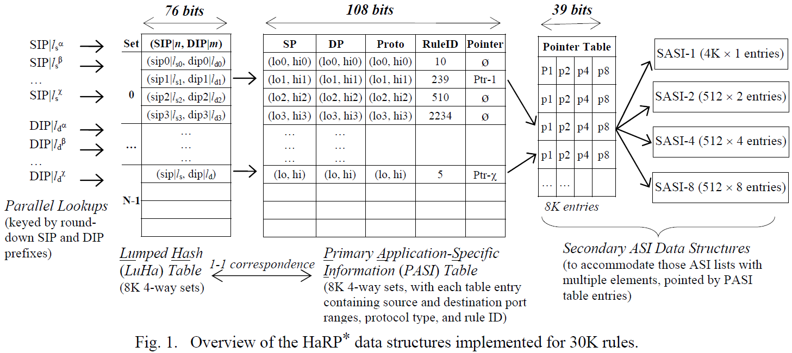
FPGA-based Design and Implementation
Layouts of Data Structures in Memory Blocks
There are four major tables involved, the LuHa table, the PASI table, the SASI table, and the Pointer table.

Slide 9
FPGA-based Design and Implementation (Cont.)
Layouts of Data Structures in Memory Blocks
There are four major tables involved, the LuHa table, the PASI table, the SASI table, and the Pointer table.

Slide 10
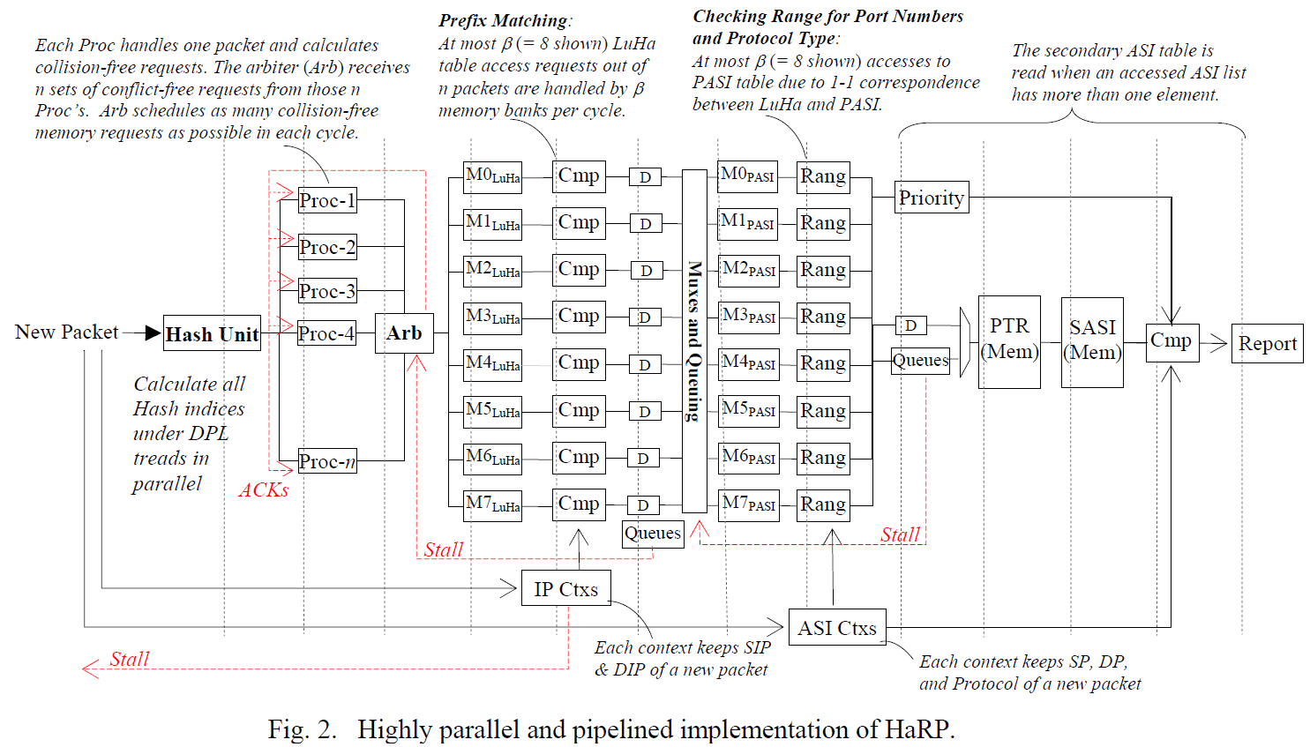
FPGA-based Design and Implementation (Cont.)
Layouts of Data Structures in Memory Blocks
The LuHa table shown in Fig. 2 consists of (= 8 shown) memory modules, with each module holding 1K sets.

Slide 11
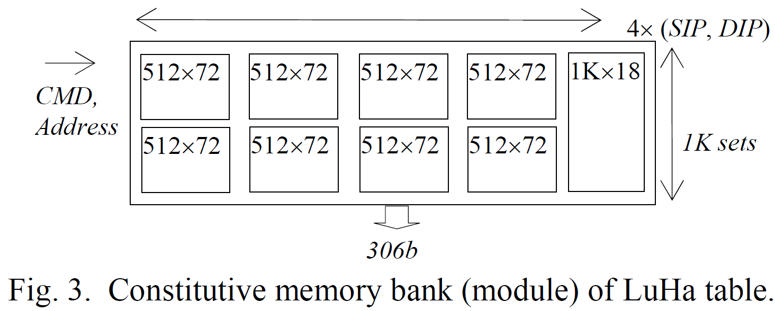
FPGA-based Design and Implementation (Cont.)
Layouts of Data Structures in Memory Blocks
Each of the memory module is made to output 306 bits per read access, rendering four (SIP|n, DIP|m) pairs resided in one set of the 4-way LuHa table as depicted in Fig. 3.

Slide 12
FPGA-based Design and Implementation (Cont.)
Layouts of Data Structures in Memory Blocks
The primary ASI (PASI) table has a 1-1 correspondence relationship to the LuHa table.

Slide 13
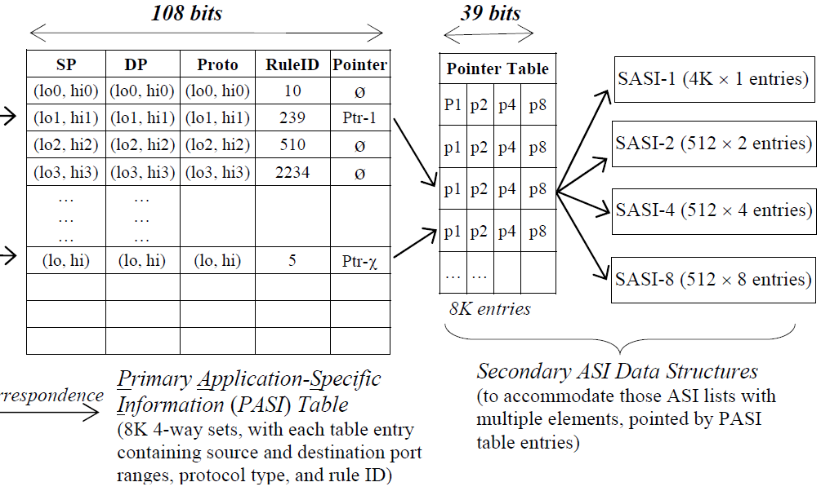
FPGA-based Design and Implementation (Cont.)
Layouts of Data Structures in Memory Blocks
While the PASI table keeps the first element, the additional elements of an ASI entry are kept in the four secondary ASI component tables, which are referred to as the SASI table for simplicity.

Slide 14
FPGA-based Design and Implementation (Cont.)
Pipelined Implementation

Slide 15
Implementation Evaluation
$DPL:\{8,20,23,27\}$ and $DPL:\{8,20,24,30\}$

Slide 16
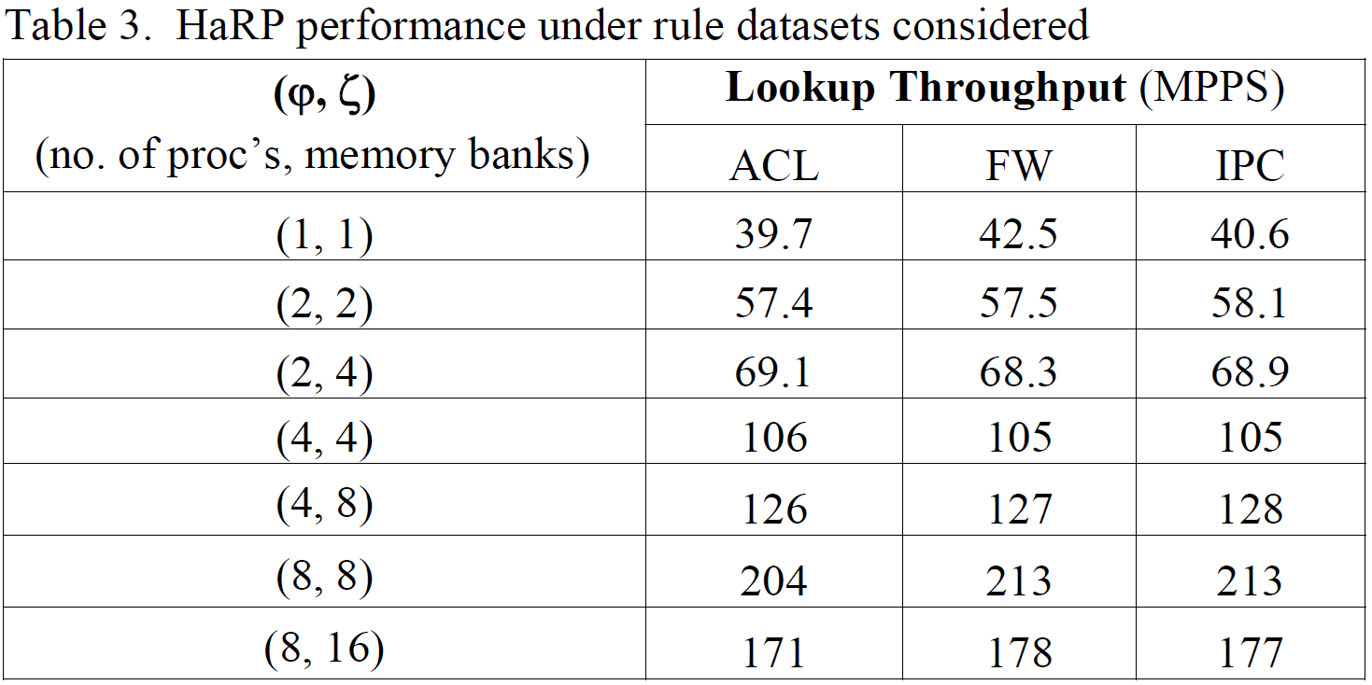
Implementation Evaluation (Cont.)

Slide 17
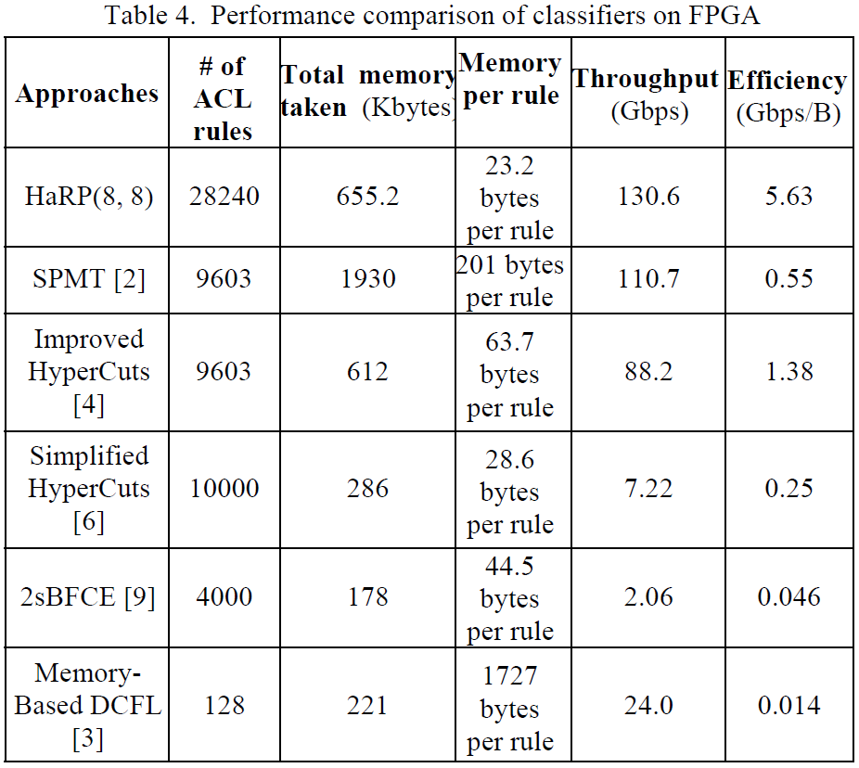
Implementation Evaluation (Cont.)

